Slide 1
PLC Controls Lab
Team 519
Grant Hoffmeyer, Jack Vranicar, Mason Walters, Onyx Oh
Virtual Design Review #6, April 3, 2025

Slide 2
Meet the Team
Grant Hoffmeyer
Grant Hoffmeyer
Systems & Test Engineer
Onyx Oh
Project Engineer
Mason Walters
Design Engineer
Jack Vranicar
Mechatronics Engineer

Slide 3
Objective
Grant Hoffmeyer
The objective of this project is to develop curriculum for Mechanical Engineering students at the FAMU-FSU College of Engineering to address the current lack of Programmable Logic Controller (PLC) training.

Slide 4
PLCs Explained
Grant Hoffmeyer
Industrial Controller
Used for Automation
Harsh Environments
Ladder Logic
Arduino OPTA RS485

Slide 5
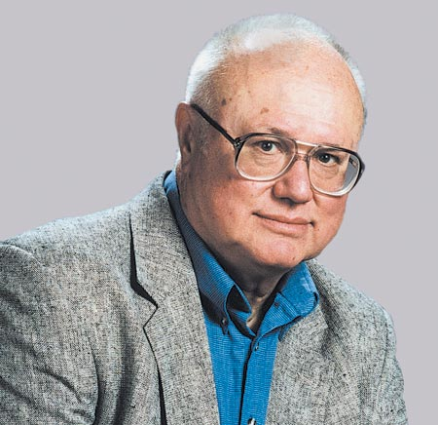
PLC History
Grant Hoffmeyer
History of the PLC | Library.AutomationDirect.com | #1 Value

Slide 6
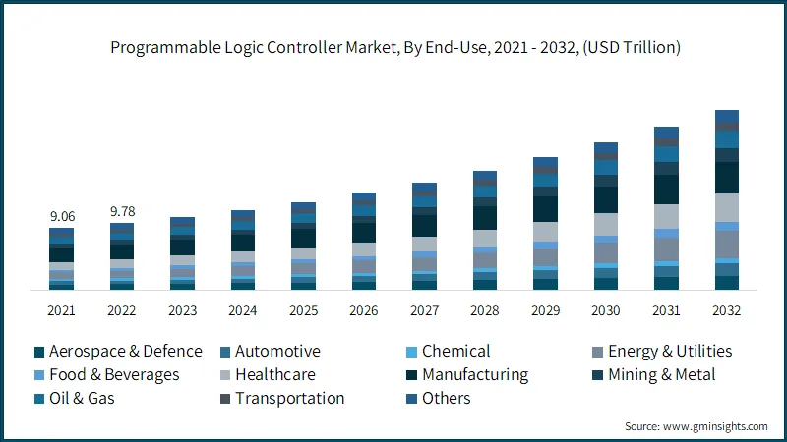
PLC Opportunities
Grant Hoffmeyer

Slide 7
Key Goals
Grant Hoffmeyer
Emphasize the importance of PLCs in the industry
Create and produce 3 labs involving PLCs
Provide student performance milestones

Slide 8
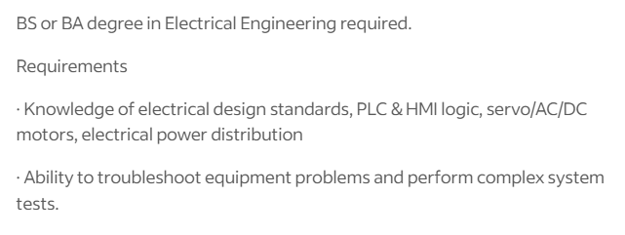
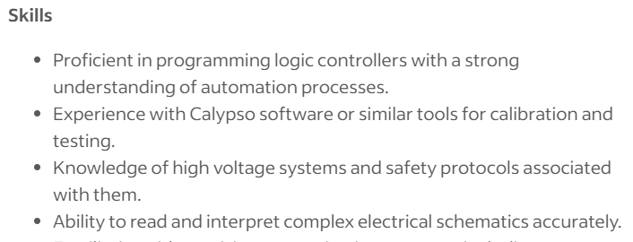
PLC Skills
Grant Hoffmeyer
PLC Engineer Jobs, Employment | Indeed

Slide 9
Lab Ideas
Grant Hoffmeyer
Logic Simulation
Hardware Introduction
Automated System
Ladder logic in MATLAB Simulink
Buttons to control LEDs and motor
Replicate simulation with hardware
Increased logic complexity
Box sorting system using buttons
Introduction of timer and counter

Slide 10
User-Friendly Simulation
Jack Vranicar
SRC
edit_simulink_plc.m
run_simulink_plc.m
Notes:
Add in some arrows here to show the relationship

Slide 11
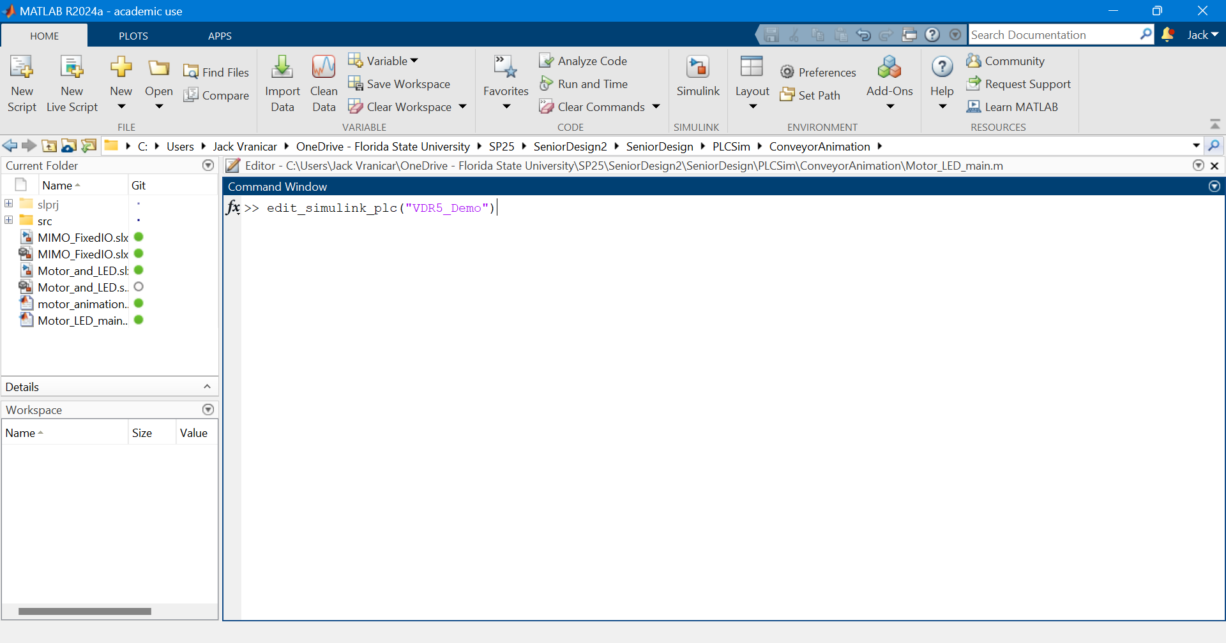
Function call
Jack Vranicar

Slide 12
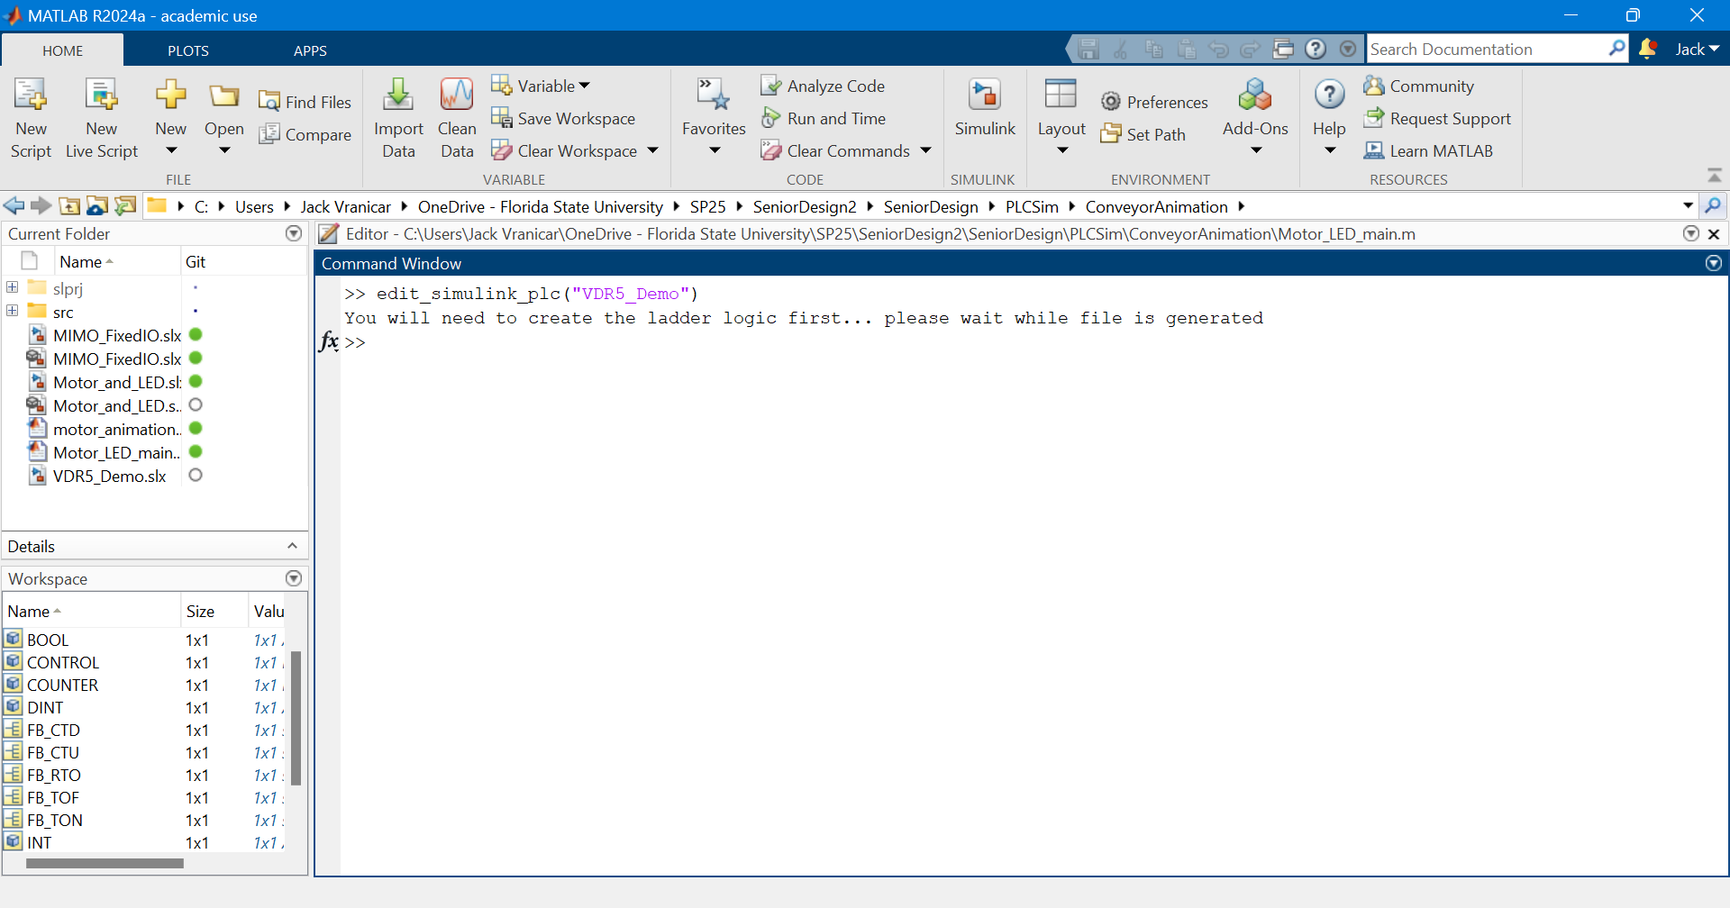
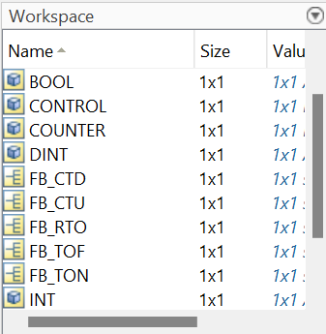
Workspace Generation
Jack Vranicar
Notes:
Add boxes of what was added in; types, automatically saved, display

Slide 13
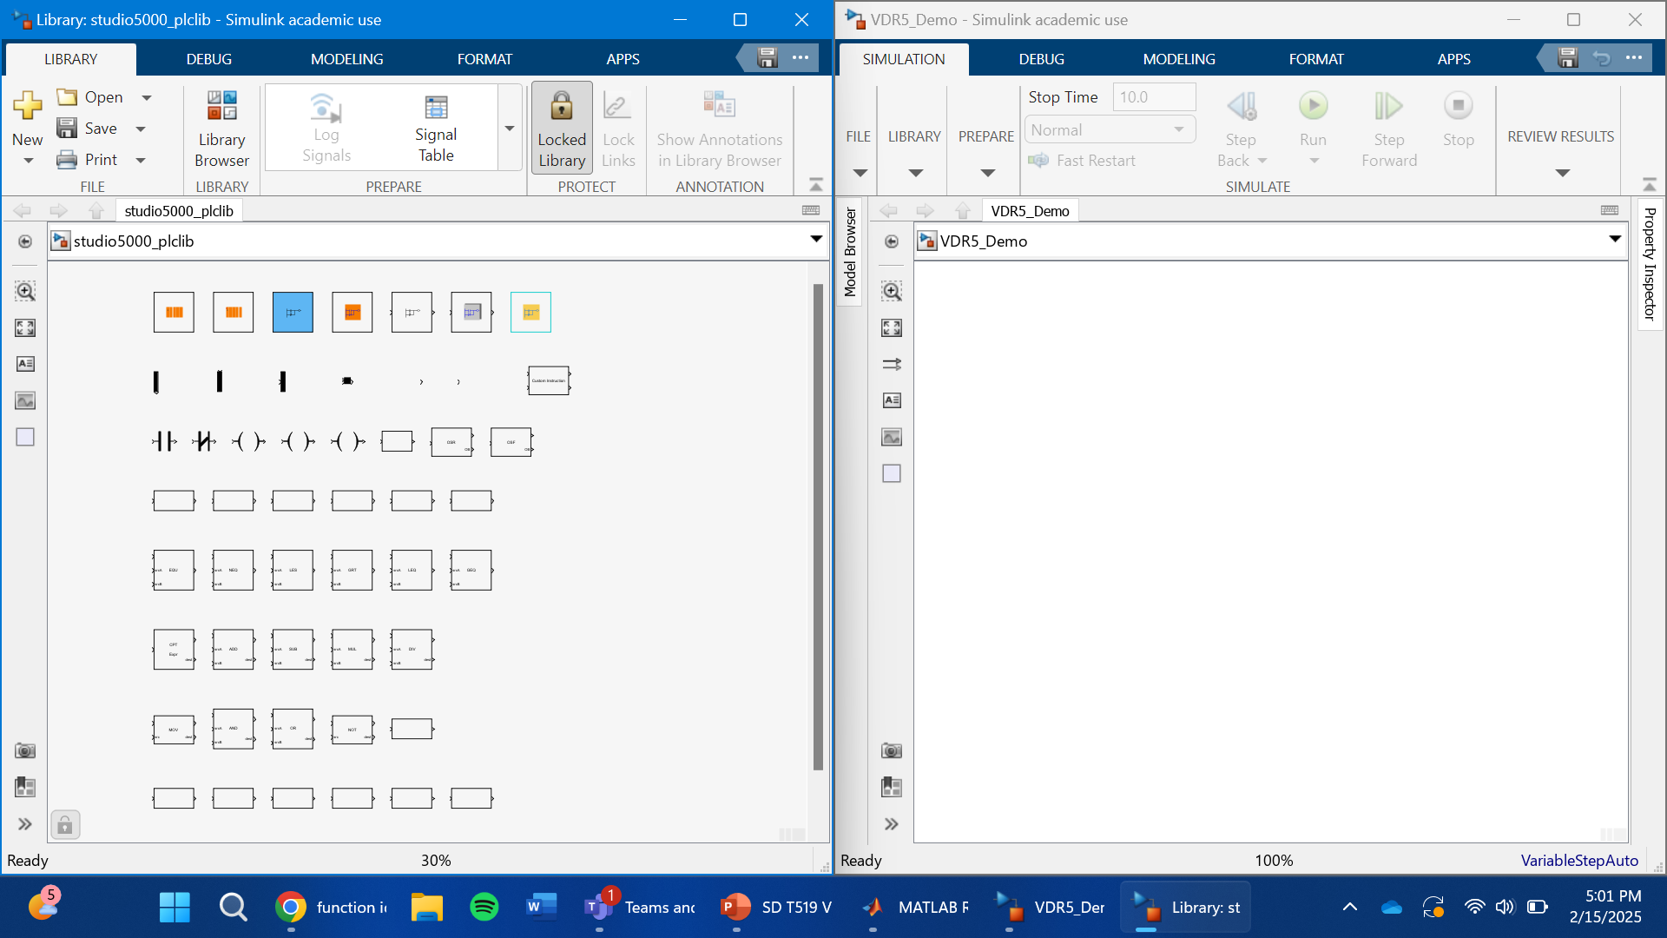
PLC Library and Simulink Opened
Jack Vranicar
Notes:
Show that automatically named

Slide 14
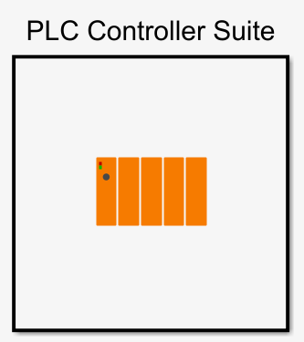
PLC Library and Simulink Opened
Jack Vranicar
Notes:
Make animation of the thing being dragged over

Slide 15
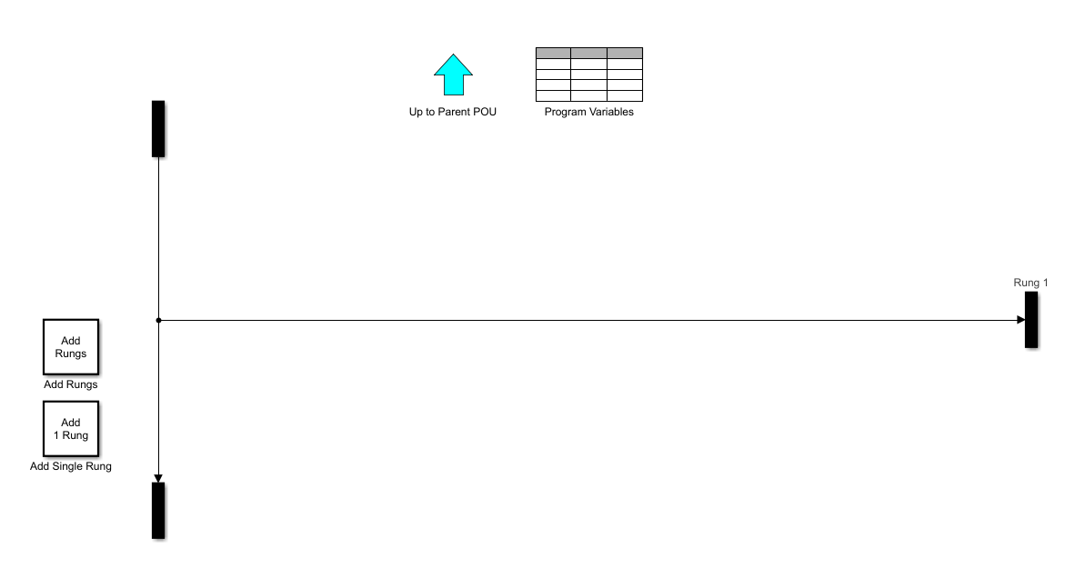
Editing Ladder Logic
Jack Vranicar
Notes:
Make animation of the thing being dragged over

Slide 16
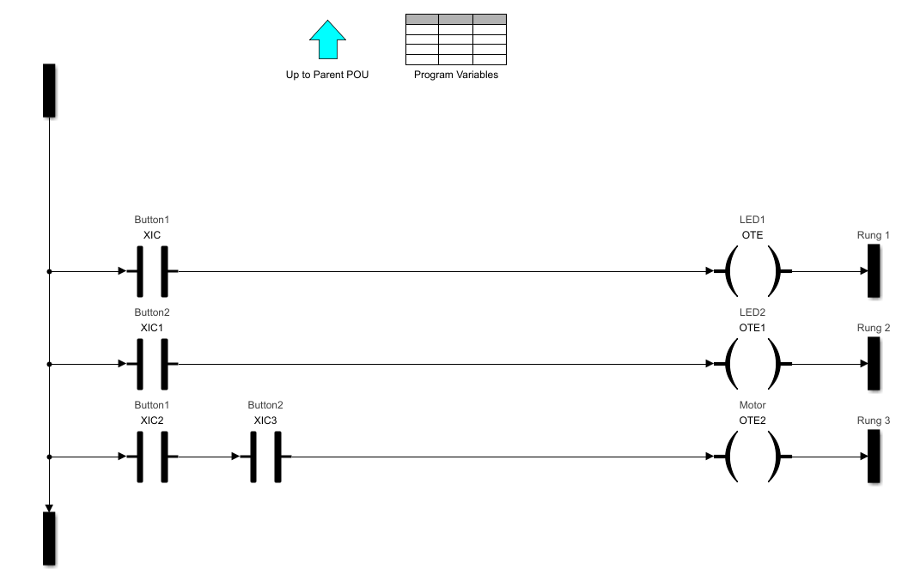
Motor and LED Ladder
Jack Vranicar
+V
GND
if(Button_1 == 1){LED1 = On}
if(Button_2 == 1){LED2 = On}
if(Button_1 == 1 && Button_2 ==1){
Motor = On }

Slide 17
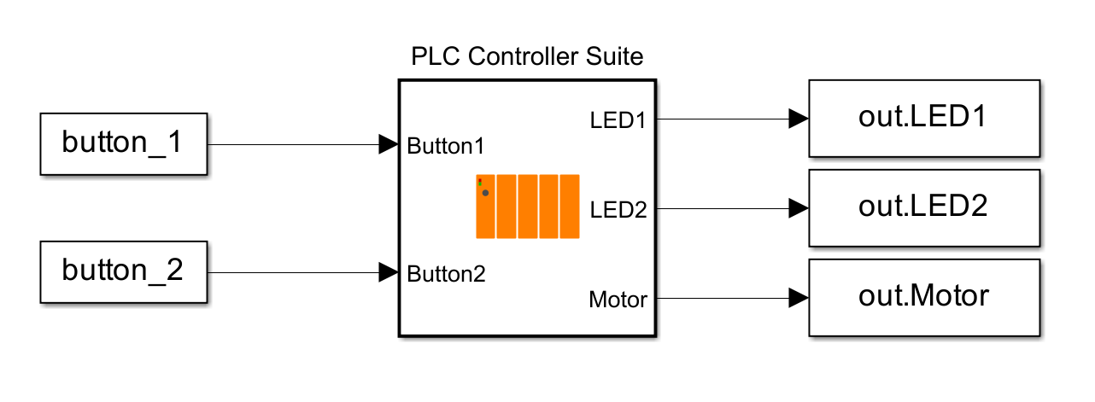
Connecting PLC to Workspace
Jack Vranicar
Notes:
Make animation of the thing being dragged over

Slide 18
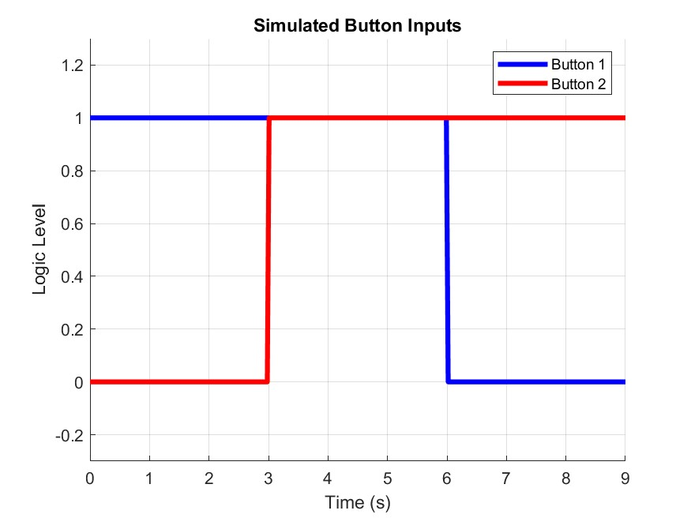
Simulating Button Inputs
Jack Vranicar
Expected Behavior:
When each button is pressed, its corresponding LED turns on.
Only when both buttons are pressed does the motor spin

Slide 19
Simulation Results
Jack Vranicar

Slide 20
Simulation Advantages
Jack Vranicar
Ladder Logic is the same
Convenient visual debugging tool which animates ‘current’
Memory addressing is the same between simulation and PLC IDE
Able to make mistakes without damaging hardware
Makes the transition to using hardware with PLCs smoother

Slide 21
Lab 2a Hardware Design
Jack Vranicar

Slide 22
Lab 2a Hardware Testing
Jack Vranicar

Slide 23
Lab 2b
Mason Walters
Notes:
Real world relevance, involves mechanical movements, sensors, motors, visual feedback

Slide 24
Mason Walters
Modular Design
Clips Components Together

Slide 25
Mason Walters
DC Motor

Slide 26
Mason Walters

Slide 27
Mason Walters

Slide 28
Lab 3
Mason Walters
Objective: Student will learn how to apply timers, counters, and advanced logic functions in a PLC to control a real-world process.
Notes:
Top 8V powers buttons, left 8V Power (A) side, when corresponding buttons are pressed, transfers to (B) side to power LED which indicated motors. Hardware decreased, software increased. Start, stop, box, BB 1, BB 2

Slide 29
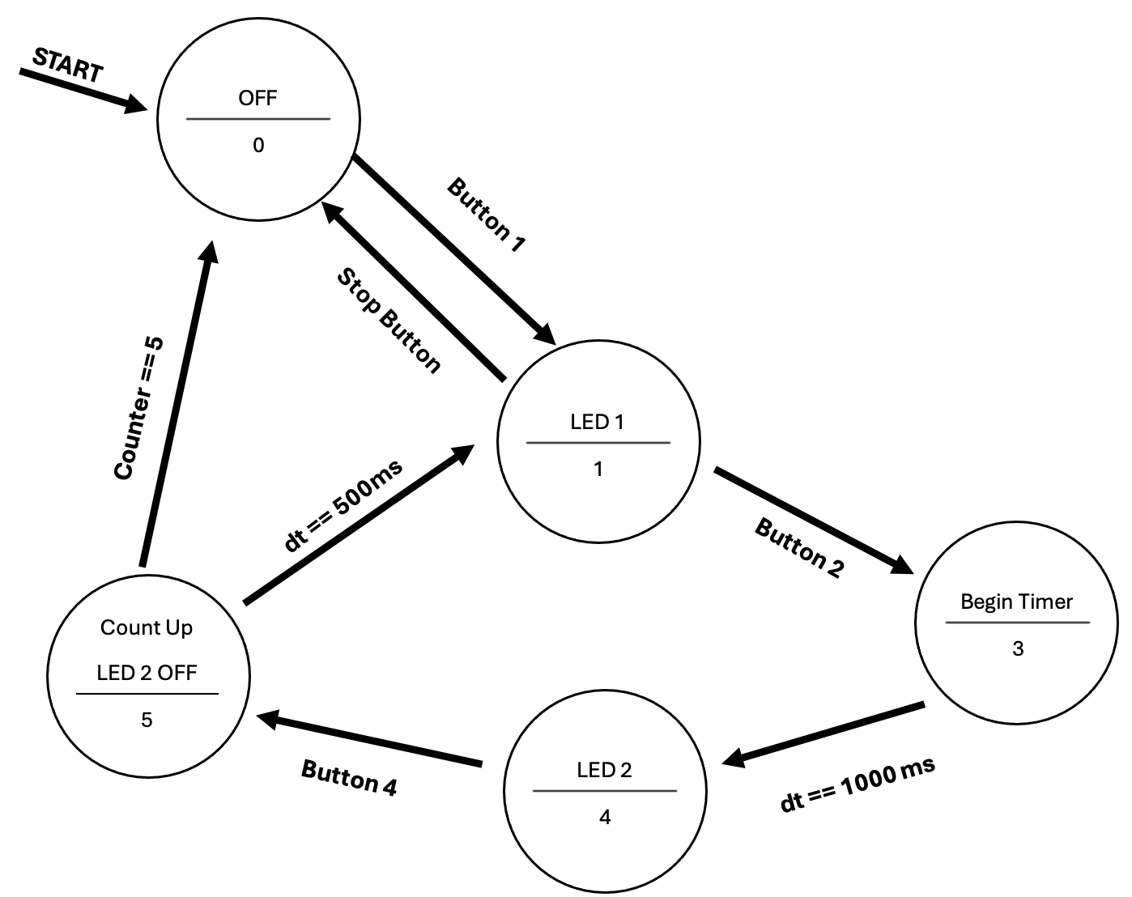
State Diagram
Mason Walters
Notes:
Activity for students, draw logic before programming to work through better.

Slide 30
Lab 4
Mason Walters
Notes:
Team 519 has created an additional lab which follows after lab 3 smoothly. Now that students have been able to successfully work with complex software, they will be expected to replicate this onto more difficult hardware. Up until this point, from lab 1 to lab 3, buttons and LEDs have been used.

Slide 31
Lab 4
Mason Walters
Break Beam Sensor
Notes:
Lab 4 will swap out buttons for break beam sensors and LEDs for the linear actuator. This lab is great for students to gain exposure on advanced techniques with PLCs and on pneumatic devices. Furthermore, the completion of this lab would give students fundamental knowledge of PLCs so that they could use it for their semester long Mechatronics project if desired.

Slide 32
Lab 4
Mason Walters
Linear Actuator
Notes:
Team 519 has created an additional lab which follows after lab 3 smoothly. Now that students have been able to successfully work with complex software, they will be expected to replicate this onto more difficult hardware. Up until this point, from lab 1 to lab 3, buttons and LEDs have been used.

Slide 33
Lab 4
Mason Walters
Notes:
Team 519 has created an additional lab which follows after lab 3 smoothly. Now that students have been able to successfully work with complex software, they will be expected to replicate this onto more difficult hardware. Up until this point, from lab 1 to lab 3, buttons and LEDs have been used.

Slide 34
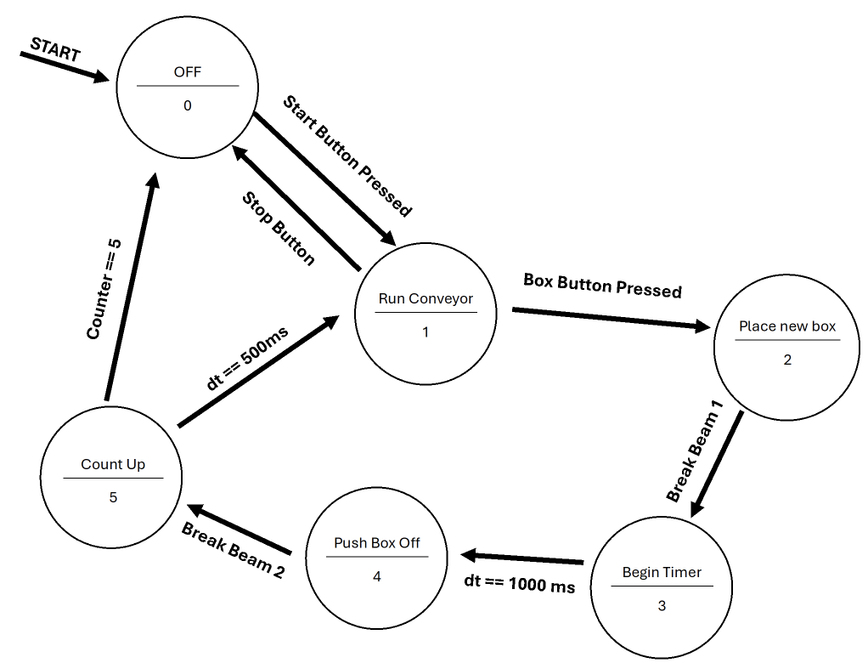
State Diagram
Mason Walters
Notes:
Activity for students, draw logic before programming to work through better.

Slide 35
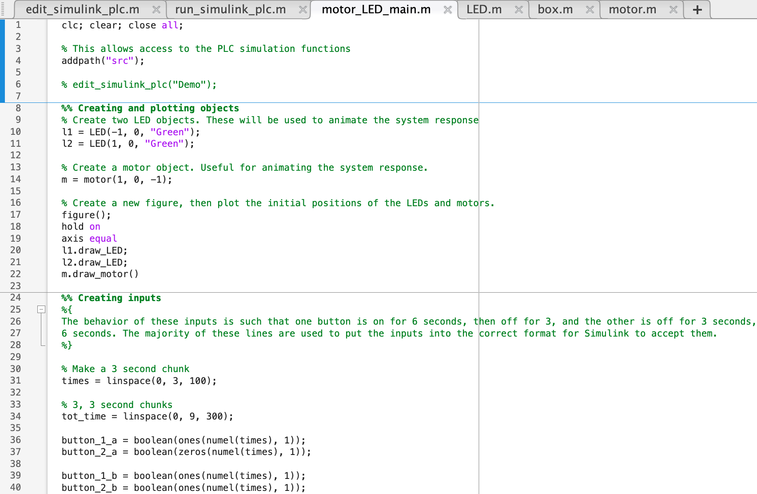
Supporting Documentation
Onyx Oh
Programs
MATLAB
Opta
Arduino
edit_simulink_plc.m
run_simulink_plc.m
motor_LED_main.m
LED.m
box.m
motor.m
Notes:
In addition to creating lab content for the curriculum, the team has worked all year creating supporting documentation for the students, TAs, and the professor.
The first type of supporting documentation will be providing tutorials and code scripts for the 3 programs used in the labs. This is for the students to have access to any complex logic and will serve as a solution guides for the TAs and professor.
MATLAB discussion
MATLAB will be used for Lab 1. There will be 6 functions provided for the students to allow for the simulation to run. A screenshot of the code for lab 1 is shown here which is the motor_LED_main.m function. Once these files are downloaded and opened up into MATLAB as shown in the highlighted circle, the simulation of the PLC will work. This function will allow for the SLX files to generate and the animation to run properly.

Slide 36
Supporting Documentation
Onyx Oh
Programs
MATLAB
Opta
Arduino
edit_simulink_plc.m
run_simulink_plc.m
motor_LED_main.m
LED.m
box.m
motor.m
Documentation for getting started with OpenPLC
Lab 2 and Lab 3 codes completed and tested
Expansion module scripts
Notes:
The second program used is OpenPLC which works for the Opta PLC. Since this is a new software being introduced, the team has provided documentation on how to get started and specific techniques such as how to define variables and creating the ladder logic diagram.
Lab 2 and Lab 3 codes were developed by the team and will be provided along with the expansion module scripts.
This is an example of the documentation that will be provided for getting started with the software. We have also included hyperlinks such as the OpenPLC Manual for additional resources if needed.

Slide 37
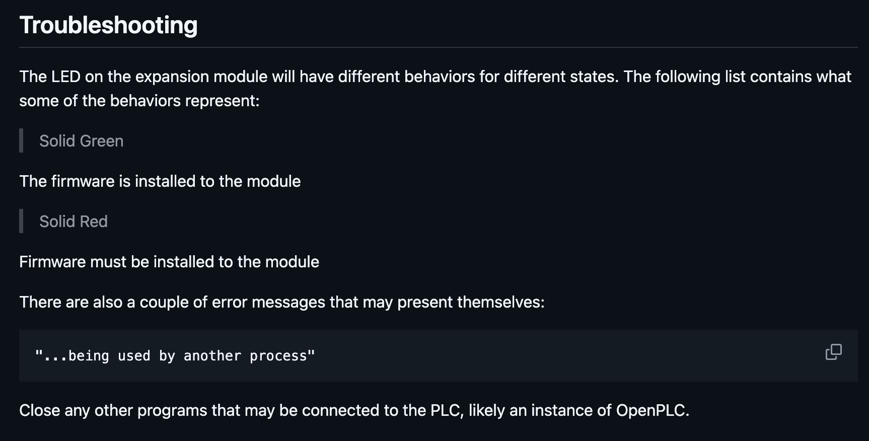
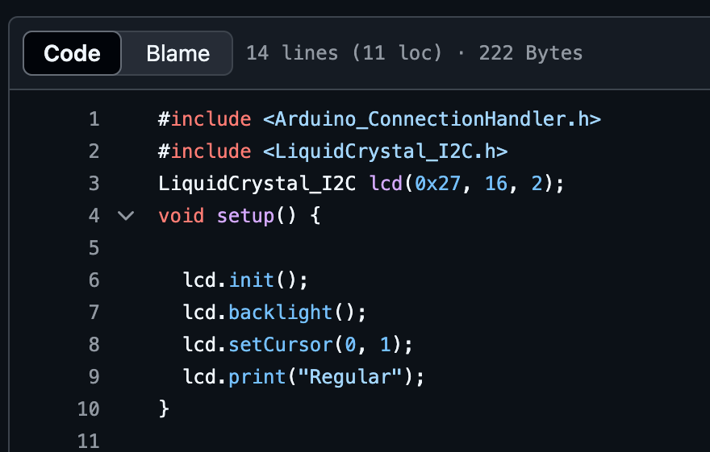
Supporting Documentation
Onyx Oh
Programs
MATLAB
Opta
Arduino
edit_simulink_plc.m
run_simulink_plc.m
motor_LED_main.m
LED.m
box.m
motor.m
Documentation for getting started with OpenPLC
Lab 2 and Lab 3 codes completed and tested
Expansion module scripts
Using ArduinoIDE to connect the expansion module
Facilitates I2C communication
Used for programming LCD screen in Labs 2 & 3
Notes:
The third program is the ArduinoIDE software that has previously been used within the curriculum so far. This software will be used to connect the expansion module for Labs 2 and 3 and program LCD screens. The expansion module will add additional I/O ports, since the Opta alone only has 4 inputs and 4 outputs.
The software facilitates any I2C communication, which allows for multiple electronic components to communicate with one another.
Our documentation will include steps on how to connect the expansion module to the PLC.
The above example includes any troubleshooting tips that were discovered through testing. The example below is a code script that serves as a solution.

Slide 38
Supporting Documentation
Onyx Oh
Lab Manuals
Lab 1: Ladder Logic
Lab 2: PLC Conveyer Belt Automation
Lab 3: Advanced PLC Conveyer Belt Automation
Background and motivation
Syntax
Activities 1 & 2
Deliverables
Safety
Activities 1, 2, 3, & 4
Deliverables
Safety
Activities 1, 2, & 3
Deliverables
Notes:
We also have created lab manuals for each of the labs that will be conducted. They all will include specific deliverables that students will need to complete to show their level of comprehension. The team has designed these lab manuals very similarly to how Dr. Ordonez has them laid out so far, keeping them open-ended allowing for students to critically think. We have included hints like wiring diagrams to help guide the students.
The lab manuals will all follow similar layouts, with introductory slides to prepare students for the labs, activities, and deliverables that will be submitted by the students. The deliverables will include submitting any state diagrams, code, and ladder logic diagrams.

Slide 39
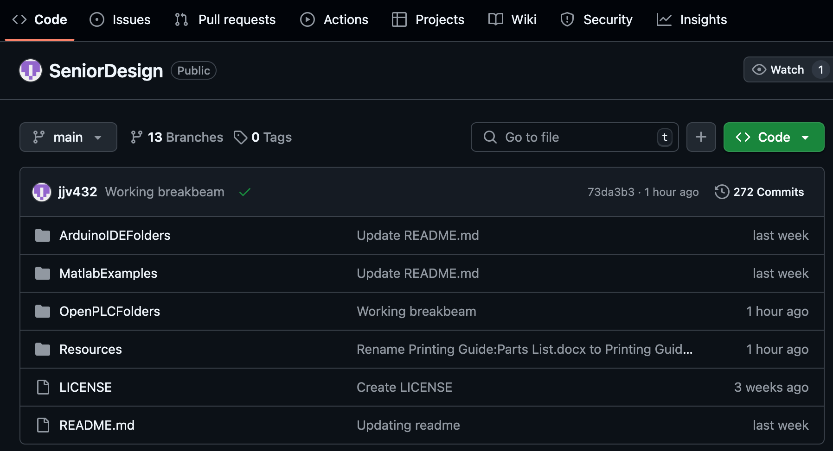
Supporting Documentation
Onyx Oh
Github
Notes:
All of Team 519’s supporting documentation is found on GitHub, which is a cloud-based website used for multiple users to collaborate on code. The main branch in the Github consists of read me text which includes background and motivation, files pertaining to the three programs used, and additional resources.

Slide 40
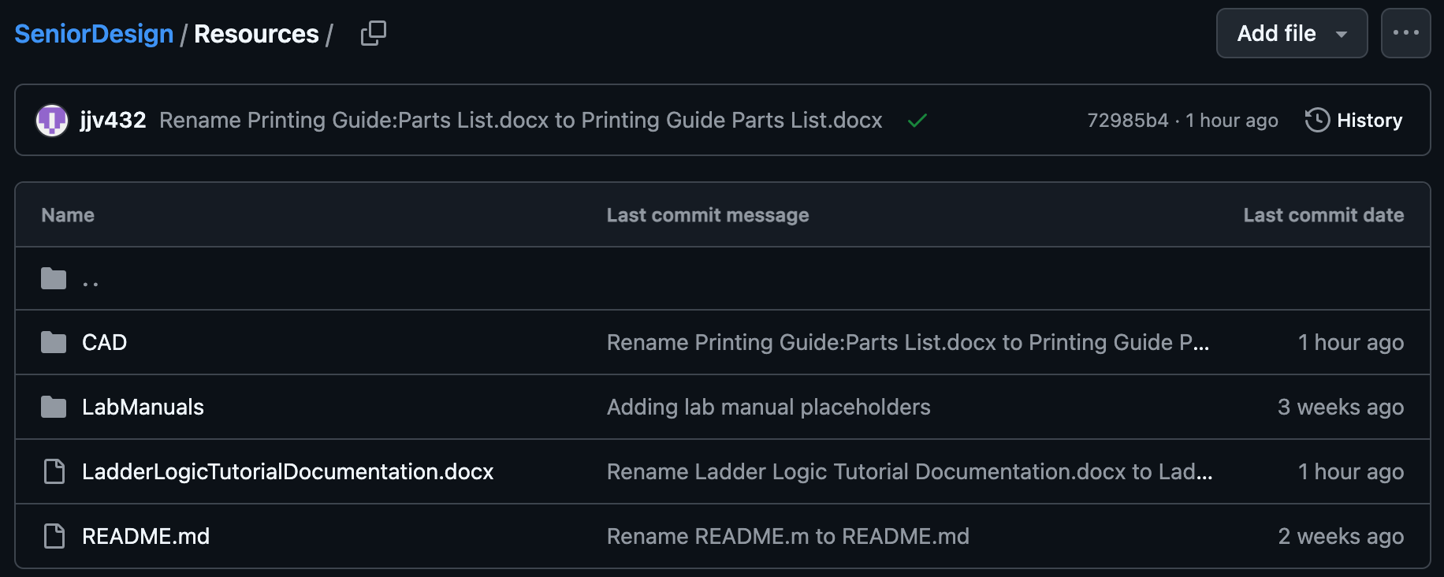
Supporting Documentation
Onyx Oh
GitHub
Notes:
Within the resources tab, the lab manuals, detailed ladder logic tutorials, and the CAD STL files can be found. These resources are meant for the Mechatronics faculty to help facilitate adding this new content within the curriculum.

Slide 41
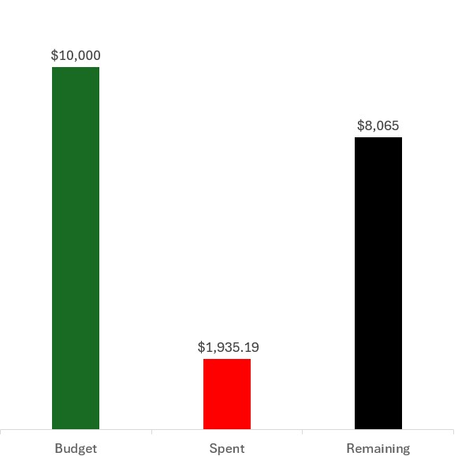
Budget
Onyx Oh
Item # | Item Description | Cost | Qty
1 | DC Motor | $3 | 1
2 | Stepper Motor | $14 | 1
3 | Break Beam Sensor | $12 | 2
4 | Hardware (Wires, breadboards, electronics) | $15 | 1
5 | Arduino OPTA PLC | $162 | 1
6 | Arduino Expansion Module | $222 | 1
7 | Linear Servo Actuator | $221 | 1
9 | PLA for printer | $15 | 2
 | TOTAL | $644.00
Item # | Item Description | Cost | Qty
1 | General Lab Stations | $664 | 12
2 | Prusa Core One 3d Printers | $1,199 | 2
3 | 10 – Drawer Husky Workbench | $798 | 1
 | TOTAL | $11,165
Development Costs
Cost Per Lab Station
Procurement Costs
TOTAL = $13,100.19
Notes:
Our total budget of $22,300 was broken down into two subcategories: $10,000 for development and $12,300 for procurement costs.
The team has spent $1,935.19 for the development of the project.
The cost per lab station is shown in a table on the right with items needed for all 4 labs, totaling around roughly $644.
After calculating the total lab stations, the team is going to include the cost of 2 3D printers that are being supplied for the lab, and the price of a workbench to store the extra material. The total procurement cost will roughly be $11,165.
All in all, that leads to a total of $13,100.19 that will be spent with the total budget given.
The remainder of the budget will be spent by our sponsor to supply the Mechatronics lab with hardware and materials that he will need for the future curriculum.

Slide 42
Key Goals Achieved
Onyx Oh
Create and produce 3 labs involving PLCs
Provide student performance milestones
Emphasize the importance of PLCs in the industry
Notes:
Team 519 has overachieved the key goals that were initially stated 9 months ago. The team has created not 3, but 4 labs that involve PLCs and PLC concepts such as ladder logic and incorporating I/O.
The team has provided student performance milestones through the lab manuals which provide deliverables that students are expected to complete.
Lastly, the team has emphasized the importance of PLCs within the industry through incorporating the motivation not only within our VDRs but also through the content that will be provided for the Mechatronics course.

Slide 43
Future Work
Onyx Oh
Complete Lab 4
Add different communication modules
Incorporate Pulse Width Modulation (PWM)
Higher voltage applications
Notes:
For future work, team 519 wants to complete lab 4 as soon as the linear actuator gets delivered.
The team wants to add different communication modules such as an ethernet cable and RS485. This allows for PLCs to communicate amongst each other.
The team wants to incorporate PWM into the current set up to allow for motor speeds to vary. We would like to incorporate a portion to the labs where the conveyer belt speed changes.
Lastly, the team would like to use higher voltage applications to closely follow real-world applications. Higher voltage applications such as higher-powered motors and linear actuators can be utilized.

Slide 44
Lessons Learned
Onyx Oh
Grant Hoffmeyer
"Research only gets you to the start line, teamwork gets you to the finish line"
Onyx Oh
“Anything that can go wrong will go wrong, so be prepared and allow time for mistakes.”
Mason Walters
“The strength of a project lies not in a perfect plan, but the team's ability to adapt when the plan changes.”
Jack Vranicar
*insert quote

Slide 45
Thank you!
Onyx Oh
Team 519: PLC Controls Lab
Team 519 Website
Github

Slide 46
References
Grant Hoffmeyer
https://www.famu.edu/academics/colleges-and-schools/engineering/index.php
https://store-usa.arduino.cc/products/opta-rs485
https://store-usa.arduino.cc/products/opta-ext-d1608e
https://www.programmingelectronics.com/arduino-ides/
https://www.rockwellautomation.com/en-us/products/hardware/allen-bradley/programmable-controllers/micro-controllers/micrologix-family/micrologix-1100-controllers.html
https://www.onshape.com/en/
https://www.gminsights.com/industry-analysis/programmable-logic-controller-market
History of the PLC | Library.AutomationDirect.com | #1 Value

Slide 47
Procurement Projection
Onyx Oh
Item # | Item Description | Cost | Qty
1 | General Lab Stations | $664 | 12
2 | Prusa Core One 3d Printers | $1,199 | 2
3 | 10 – Drawer Husky Workbench | $798 | 1
≈ $11,164 total
Notes:
Hardware will be dictated on what Dr. Ordonez specifically wants to use, but some examples could be male to male connectors, male to female connectors, breadboards, etc.

Slide 48
Ideal Lab (Back up for now)

Slide 49
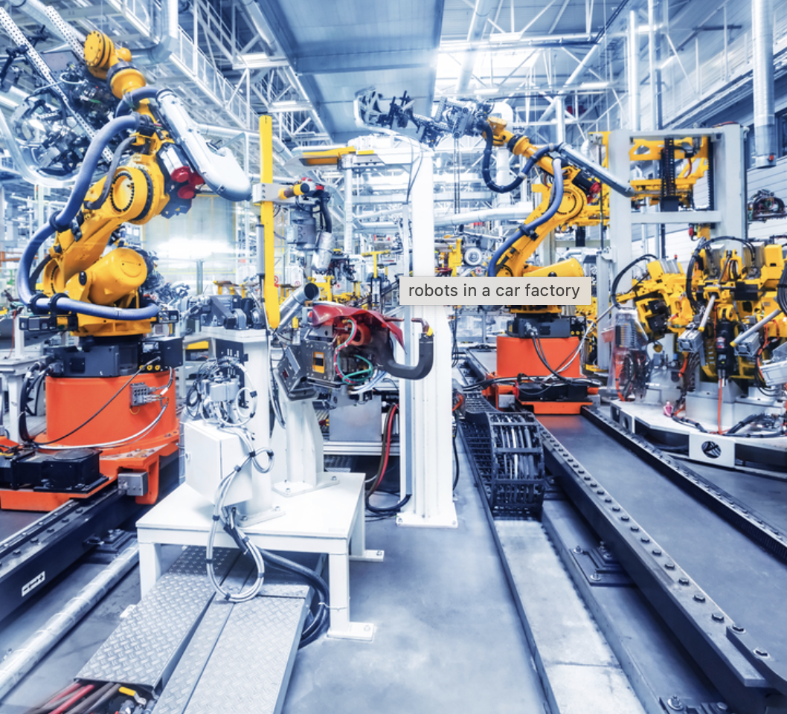
Why a Conveyor Belt?
Grant Hoffmeyer
Real World Relevance
Involves mechanical movement, sensors, motors, and logic control
Visual Feedback
Scalable Complexity
Engaging and Interactive
https://power-packconveyor.com/five-benefits-of-automated-conveyor-systems/

Slide 50
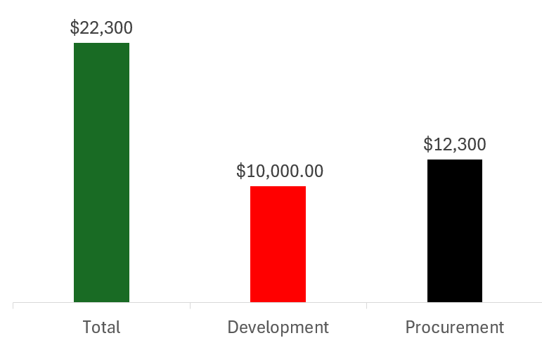
Budget
Grant Hoffmeyer

Slide 51
Overview
Onyx Oh
Key Goals
Emphasize the importance of PLCs in the industry
Create and produce 3 labs involving PLCs
Provide student performance milestones

Slide 52
Overview
Onyx Oh
Critical Targets
PLC Learning System
Control
Plant
Facilitate
Control I/O
Move motors
Manage data
Supply power
Integrate logic
Interpret visual feedback
Guide students
Guide faculty

Slide 53
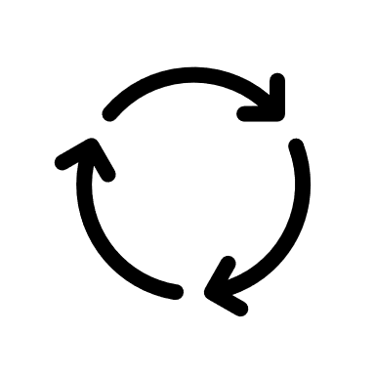
Concept Selection
Onyx Oh
Break beam Sensor
Stepper arm
Conveyer Belt

Slide 54
Onyx Oh
Break beam Sensor
Stepper arm
Conveyer Belt

Slide 55
Concept Selection
Onyx Oh
Notes:
This design is simple yet effective with real world applications. Conveyer belts are commonly used with PLCs as they are used in grocery stores and large manufacturing facilities.

Slide 56
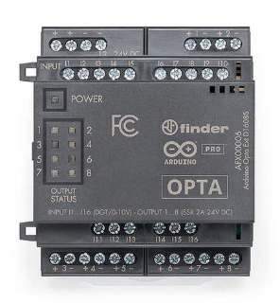
Programmable Logic Controller
Onyx Oh
Expansion module
Arduino PLC IDE
8 outputs
4 outputs
Arduino OPTA RS485
Allen Bradley CompactLogix
Notes:
Chose the Arduino to make the transition easier for students as well as being able to purchase a multitude of them for each lab group to have their own… (any more reasons I can add?)
What is the Arduino application/software we use now in the labs?

Slide 57
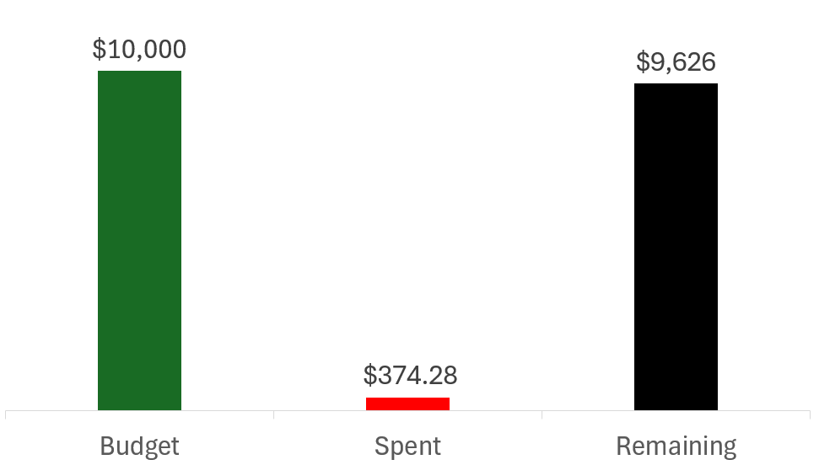
Budget
Onyx Oh
Notes:
$10,000 for project
$12,000 for supplying the classroom

Slide 58
Cost Per Lab Set Up
Onyx Oh
Item # | Item Description | Cost
1 | DC Motor | $2.95
2 | Stepper Motor | $15.94
3 | Break Beam Sensor | $3.59
4 | Hardware (Wires, breadboards, electronics) | $30.00
5 | Arduino OPTA PLC | $159.95
6 | Arduino Expansion Module | $139.80
≈ $352.23
Notes:
Hardware will be dictated on what Dr. Ordonez specifically wants to use, but some examples could be male to male connectors, male to female connectors, breadboards, etc.

Slide 59
Scope Increase
Mason Walters
All parts will be made by 3D printer
Purchasing materials for a full class size plus ½
Lab station remodeled for PLC lab components
59

Slide 60
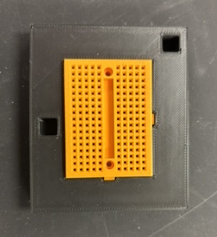
Old vs. New Design
Mason Walters

Slide 61
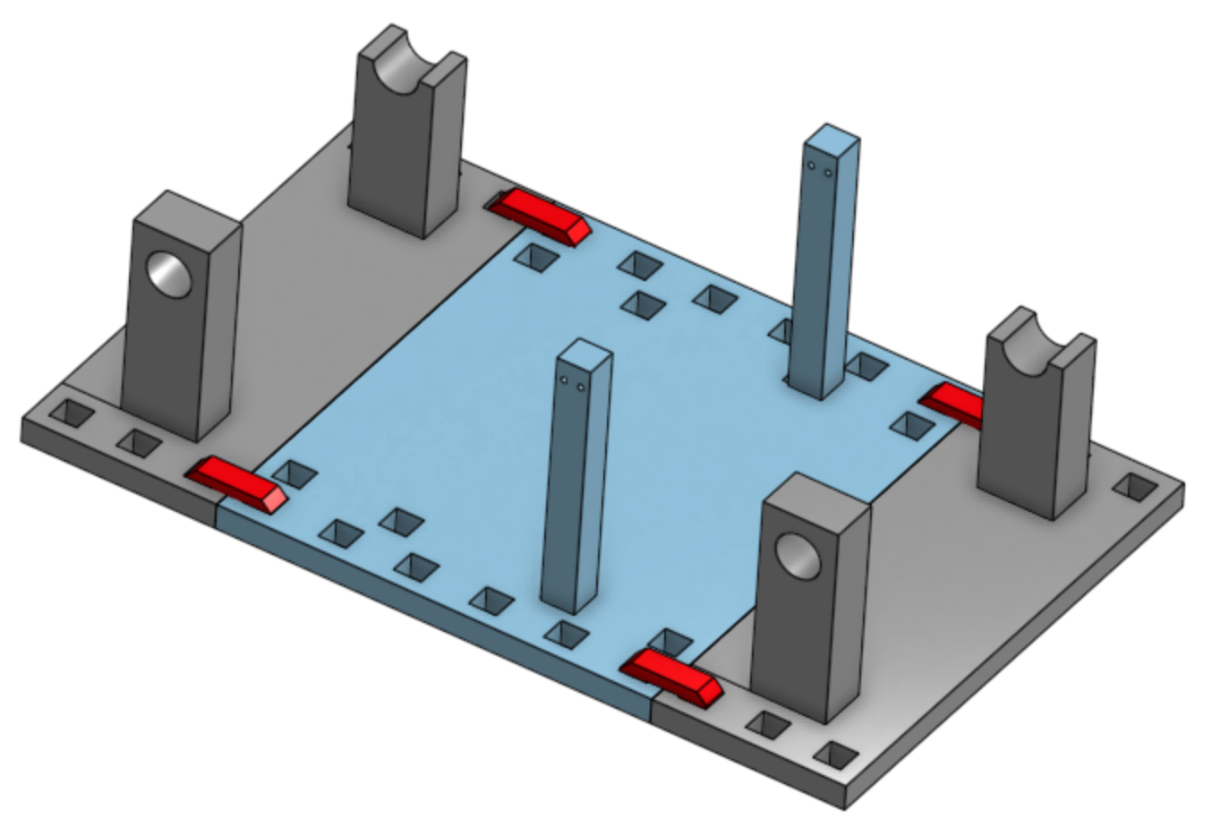
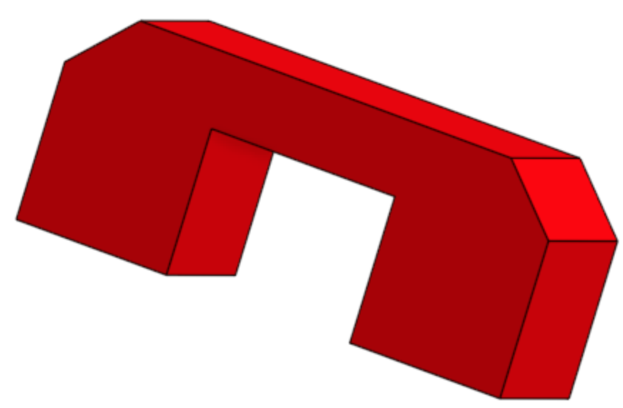
Design Improvements
Mason Walters

Slide 62
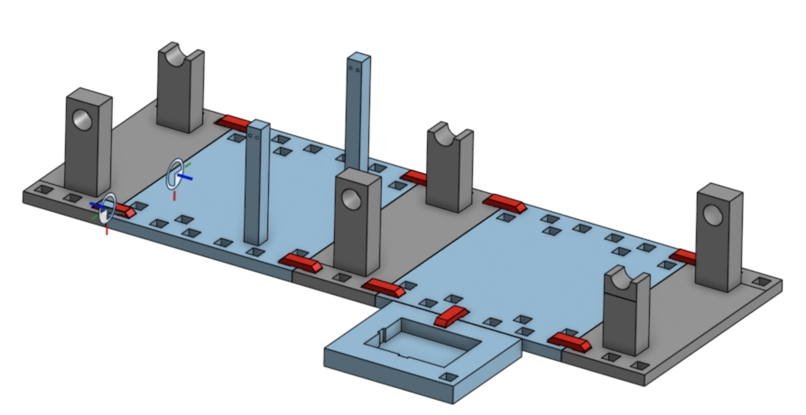
Design Improvements
Mason Walters
Versatile design
Increased combinations of hardware
Helps labs build on from the previous
Allows students for customize for their own Mechatronics project

Slide 63
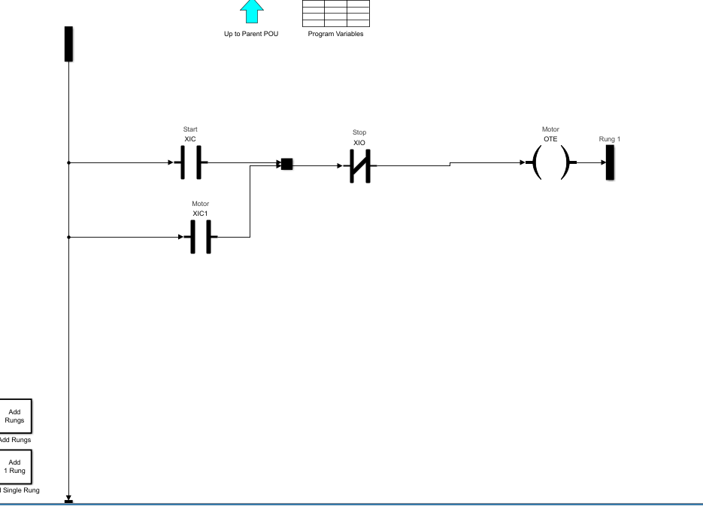
Ladder Logic Simulation
Notes:
Just explain briefly that we have been messing with a ladder logic simulation done with the simulink toolbox on MATLAB
Explain what each symbol means briefly and what this ladder logic diagram is doing

Slide 64
Future Work
Mason Walters
Print and assemble new prototype
Collaborating with sponsor to create lab documentation
Remodel Mechatronics lab to include PLC lab material
Order parts (About 42 Units)

Slide 65
Thank you!
Mason Walters
Team 519: PLC Controls Lab

Slide 66
References
Mason Walters
https://www.famu.edu/academics/colleges-and-schools/engineering/index.php
https://store-usa.arduino.cc/products/opta-rs485
https://store-usa.arduino.cc/products/opta-ext-d1608e
https://www.programmingelectronics.com/arduino-ides/
https://www.rockwellautomation.com/en-us/products/hardware/allen-bradley/programmable-controllers/micro-controllers/micrologix-family/micrologix-1100-controllers.html
https://www.onshape.com/en/

Slide 67
Ladder Logic Example
Jack Vranicar

Slide 68
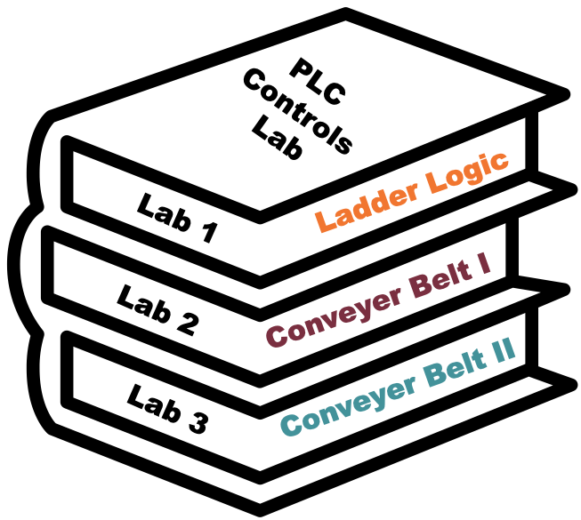
Curriculum Design
Mason Walters
Lab 1: Ladder Logic
Lab 2: Conveyer
Belt I
Lab 3: Conveyer
Belt II
Pre-lab activity: Online Ladder Logic
Lab: Control light via button/switch and activate relay using ladder logic
Pre-lab activity: 3D Print necessary parts
Lab: Run conveyer belt via DC motor
Pre-lab activity: 3D Print necessary parts
Lab: Add sensors and motor to system

Slide 69
PLC Controls Lab
Team 519
Grant Hoffmeyer & Jack Vranicar
Virtual Design Review #2, November 12, 2024

Slide 70
Meet the Team
Onyx Oh
Grant Hoffmeyer
Systems Engineer
Onyx Oh
Test Engineer
Mason Walters
Design Engineer
Jack Vranicar
Software Engineer

Slide 71
Sponsor and Advisor
Onyx Oh
Industry Collaborator
Rockwell Automation
Sponsor
Dr. Camilo Ordoñez
Academic Advisor
Dr. Shayne McConomy

Slide 72
Objective
Onyx Oh
The objective of this project is to develop curriculum for Mechanical Engineering students at the FAMU-FSU College of Engineering to address the current lack of Programmable Logic Controller (PLC) training.
https://meetings.informs.org/wordpress/phoenix2023/exhibit-hall/famu-fsu-college-of-engineering-industrial-manufacturing/

Slide 73
What is a PLC?
Onyx Oh
Programmable Logic Controllers (PLCs) are computers that are widely used to control industrial equipment. They facilitate manufacturing and production lines by analyzing inputs and controlling outputs.
https://www.solutiontree.com/blog/enhancing-plc-process/

Slide 74
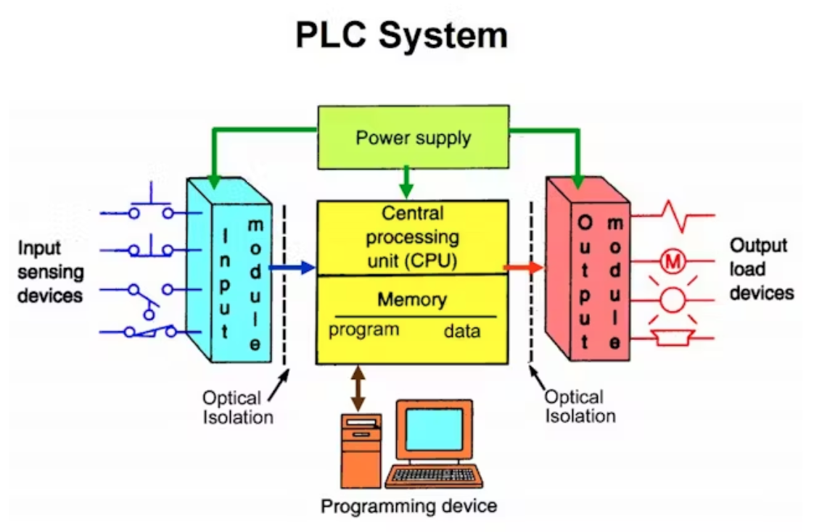
Why PLCs?
Onyx Oh
Reduce costs
Saves time
Minimal manual labor
~$11.6 billion market value
https://www.amazon.com/EJWFASCV-BMEH586040-Redundant-Industrial-Environments/dp/B0D982QLGM
Notes:
PLCs reduce costs, saves time, and yields little to no manual labor. The current market value of PLCs is roughly $11.6 billion and is expected to continue to grow by 4.7% in the next eight years

Slide 75
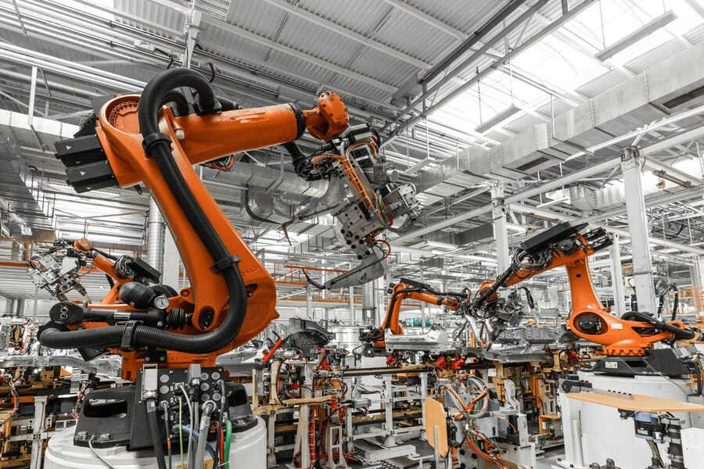
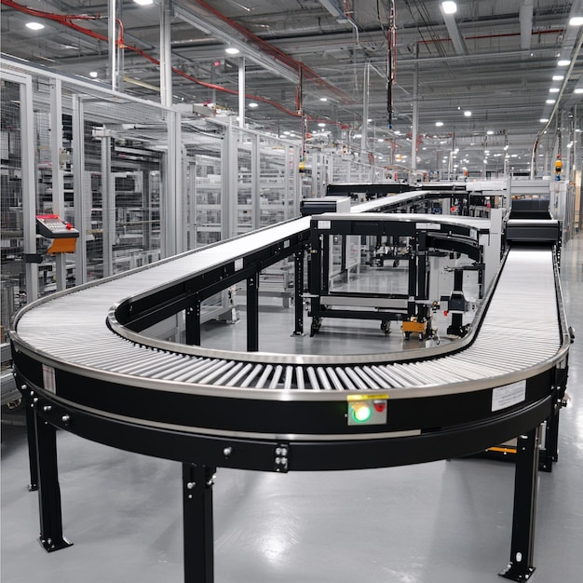
Applications of PLCs
Onyx Oh
https://www.freepik.com/free-photo/photo-automobile-production-line-welding-car-body-modern-car-assembly-plant-auto-industry_26150191.htm#fromView=search&page=1&position=6&uuid=fd68e528-1825-48bf-a991-c38e381b081b
https://www.freepik.com/premium-ai-image/automated-conveyor-systems-moving-products-different-stages-production-process_298771504.htm#fromView=search&page=1&position=13&uuid=122b5ab9-a6d8-4dd6-9324-f5d8c1f74f42

Slide 76
Key Goals
Onyx Oh

Slide 77
Key Goals
Onyx Oh
Design and produce three labs that introduce the fundamentals of PLCs, programming methods, and troubleshooting techniques
Create curriculum that emphasizes the importance and opportunities associated with PLCs, as they are widely used in many different industries
Ensure students can apply logic principles to various PLC models and applications
Create performance milestones through implementing post lab-assessments and surveys

Slide 78
Assumptions
Onyx Oh
Access to shop facilities, tools, materials, university
personnel, & communication
PLC equipment and hardware will be provided by the university
Students will have a basic understanding of Mechatronics concepts from the course and pre-requisites
The professor and teaching assistants will be competent to supervise labs and teach the material

Slide 79
Assumptions
Onyx Oh
Labs will take place in the Mechatronics Lab at the College of Engineering (Room B356)
Legal and safety protocols will be implemented in the lab
The classroom will obtain electrical safety equipment prior to labs utilizing PLCs
Liquids or food will be prohibited in the lab

Slide 80
Primary Markets
Mason Walters
Dr. Camillo Ordonez,
Mechatronics 1 Professor
Mechatronics 1 Students

Slide 81
Secondary Markets
Mason Walters
Outside Universities
PLC Manufacturers

Slide 82
Stakeholders
Mason Walters
 | Investors | Decision Makers | Advisors | Receivers
Sponsors | Dr. McConomy Dr. Ordonez | Dr. Ordonez | Dr. McConomy Dr. Ordonez | Dr. McConomy Dr. Ordonez
Managers | Dr. McConomy Dr. Ordonez | Dr. McConomy Dr. Ordonez | Dr. McConomy Dr. Ordonez | Dr. McConomy Dr. Ordonez
Experts | Rockwell Auto. | Rockwell Auto. | Dr. McConomy Dr. Ordonez | Rockwell Auto.
Operators | N/A | Dr. Ordonez | Dr. Ordonez Rockwell Auto. | Dr. Ordonez Students, TA's Rockwell Auto.
General Readers | N/A | Dr. Ordonez | Dr. McConomy Dr. Ordonez | Dr. McConomy Dr. Ordonez Students, TA's General Public

Slide 83
Stakeholders
Mason Walters
 | Investors | Decision Makers | Advisors | Receivers
Sponsors | Dr. McConomy Dr. Ordonez | Dr. Ordonez | Dr. McConomy Dr. Ordonez | Dr. McConomy Dr. Ordonez
Managers | Dr. McConomy Dr. Ordonez | Dr. McConomy Dr. Ordonez | Dr. McConomy Dr. Ordonez | Dr. McConomy Dr. Ordonez
Experts | Rockwell Auto. | Rockwell Auto. | Dr. McConomy Dr. Ordonez | Rockwell Auto.
Operators | N/A | Dr. Ordonez | Dr. Ordonez Rockwell Auto. | Dr. Ordonez Students, TA's Rockwell Auto.
General Readers | N/A | Dr. Ordonez | Dr. McConomy Dr. Ordonez | Dr. McConomy Dr. Ordonez Students, TA's General Public

Slide 84
Customer Needs
Mason Walters
Customer Need #1
The curriculum should prepare students to broaden their skill sets for future employment opportunities
Customer Need #3
Focus on software and hardware troubleshooting with a focus in ladder logic
Customer Need #2
The curriculum should match the content covered at other universities and preliminary training
Beneficial concepts added to the labs would include the creation of communication networks, human machine interfaces (HMIs), and structured text
Customer Need #4
Notes:
Customer need #1: Content should provide students with introductory understanding (Q1), prior experience simulating an automated system will allow students to succeed as a new employee (Q8)
Customer need #2: Content matches the quality that is produced at other universities (Q2), content should match concepts covered in Rockwell’s training toolkit to reduce the learning curve for new employees (Q4), curriculum will support Rockwell’s training material (Q10)
Customer need #3: ladder logic is crucial for Rockwell’s training (Q3), students will be best prepared with conditions that match the industry, which includes software and hardware troubleshooting (Q6)
Customer need #4: communication networks is an advanced skill (Q7), HMI development is an advanced skill (Q9)

Slide 85
Functional Decomposition
Mason Walters
PLC Learning System
Control
Facilitate
Plant

Slide 86
Functional Decomposition
Mason Walters
Control
Integrate logic
Interpret visual feedback

Slide 87
Functional Decomposition
Mason Walters
Plant
Control inputs and outputs
Move motors
Supply power
Receive input signal
Deliver output signal
Manage data
Record data
Communicate Data
Limit maximum voltage
Limit maximum current
Disconnect power

Slide 88
Functional Decomposition
Mason Walters
Facilitate
Guide students
Guide faculty
Transfer instructions
Provide safety protocols
Transfer critical knowledge
Provide performance measures

Slide 89
Looking Forward
Mason Walters
Receive material/training from Rockwell
Coordinate with Center of the Advancement of Teaching
Familiarize ourselves with FSU and Rockwell licensing and vending processes
Continue learning and programming PLCs using Ladder Logic

Slide 90
Hardware

Slide 91
Back Up Slides

Slide 92
Slide Headline
Try to keep text at 16 pt minimum.
Try to put as few words as possible on the slide if you’re using for a presentation.
Mix and match the backgrounds as shown in this template or just use one throughout.
You can put department/unit logos in slide master at Horizontal 0.89” Vertical 6.44” From top left corner

Slide 93
Font Check
This is 10-point
This is 15–point Times
This is 20–point
This is 25–point
This is 30–point
This is 35–point
This is 40–point
This is 50–point
This is 60–point
This is 72–point
Notes:
Use at least 20-point font in Room A105, B134, and B136
Use at least 25-point font in Room B135

Slide 94
College of Engineering Color Palette
1 2 3 4
Pantone: PMS 195 C
RGB: 120, 47, 64
Hex: #782F40
CMYK:19, 90, 50, 55
1 2 3 4
Pantone: Black C
RGB: 0, 0, 0
Hex: #000000
CMYK:0, 0, 0, 100
Garnet
Black
1 2 3 4
RGB: 238, 118, 36
Hex: #EE7624
CMYK:2, 66, 99, 0
1 2 3 4
Pantone: PMS 000C
RGB: 255, 255, 255
Hex: #FFFFFF
CMYK: 0, 0, 0, 0
Fang
Orange
White
Notes:
Avoid 75% Black in B135

Slide 95
Accent Color Palette
1 2 3 4
RGB: 0, 59, 111
Hex: #003B6F
CMYK:
1 2 3 4
RGB: 0, 59, 111
Hex: #003B6F
CMYK:
1 2 3 4
RGB: 251, 236, 93
Hex: #FBEC5D
CMYK:
1 2 3 4
RGB: 219, 215, 210
Hex: #DBD7D2
CMYK:
1 2 3 4
RGB: 251, 236, 93
Hex: #FBEC5D
CMYK:
1 2 3 4
RGB: 219, 215, 210
Hex: #DBD7D2
CMYK:
Tardis Blue
Tardis Blue
Corn
Timberwolf
Corn
Timberwolf
1 2 3 4
RGB: 206, 0, 88
Hex: #CE0058
CMYK: 0, 100, 43, 12
1 2 3 4
RGB: 206, 0, 88
Hex: #CE0058
CMYK: 0, 100, 43, 12
1 2 3 4
RGB: 104, 40, 96
Hex: #682860
CMYK:
1 2 3 4
RGB: 220, 220, 220
Hex: #DCDCDC
CMYK:
Rubine Red
Rubine Red
Imperial
Gainsboro
1 2 3 4
RGB: 72, 146, 155
Hex: #48929b
CMYK:
1 2 3 4
RGB: 64, 224, 208
Hex: #40E0D0
CMYK:
1 2 3 4
RGB: 255, 139, 0
Hex: #FF8B00
CMYK:
Asagi-iro
Turquoise
American Orange
Notes:
Remove American orange add hyperlink grey
Make corn the last for b135
All work in 134 imperial move later
Tardis doesn’t work in b136

Slide 96
F7AB19
D67F15
EE7624
D64615
F73119
Analogous
6E3610
F0A16C
EE7624
6E4931
BASB1C
Monochromatic
A14508
4BED3B
EE7624
250CED
2010A1
Triad
A1470C
FF8C40
EE7624
0098A1
24E2ED
Complementary
28A164
2FED8D
EE7624
0848A1
1871ED
Split Complementary
EDAC2F
3BED93
EE7624
0C6AED
ED2F18
Double Split Complementary
ED660C
C7ED3B
EE7624
0CE1ED
A418ED
Square
BA7E09
87724A
EE7624
60EFCF
09BA61
Compound
https://color.adobe.com/create/color-wheel
AD551A
6E3610
EE7624
FA7625
D46820
Shades
Notes:
These are the variants that work well with Fang Orange. The bolded items show well on the projectors.

Slide 97
85412D
8F3831
782f40
8F3176
792D85
Analogous
C44D69
8E626D
782F40
C48796
451B25
Monochromatic
C43959
78743B
782F40
236178
43A2C4
Triad
C43959
C46078
782F40
25C43D
2F783A
Complementary
93C460
577835
782F40
39C49D
297861
Split Complementary
784435
5A783B
782F40
237860
6E2978
Double Split Complementary
782337
78683b
782F40
237830
293978
Square
AB4D32
DEBAAF
782F40
5D8555
70AB32
Compound
https://color.adobe.com/create/color-wheel
38161E
C44D69
782F40
853447
5E2532
Shades

Slide 98
A105
A105
B135 Stage Left
B135 Stage Right
B136
B134, A105
B135

Slide 99
Border Line
Border Line
Border Line
Center of White Space
Center of Slide
Middle of Slide
Middle of White Space
Edge of Branding
Border Line
Notes:
Vertical lines from top down.
Borderline and top of title. (0.5 inch)
Center of Slide (0 inch y-direction for the entire slide)
Center of Design Content (0 inch y-direction considering the title, footer, and negative space)
Bottom of Design Content (0.25 in gap to the footer. 0.75 to the bottom of the screen)
Horizontal lines from left to right
Borderline (0.5 inch)
Center of design content.
Center of slide (0 inch y-direction for the entire slide)
Borderline (0.125 inch all around)

